Slide 1
AAVS processing: Uniboard implementation

Slide 2
UNIBOARD
Jive led FP7 project
UniBoard, high integration density
    >> processing / m3
    << power
    << hardware costs
One board for multiple applications

Slide 3
AAVS1
Assumption:
256 antenna elements distributed over
  4 stations
  64 elements each

Slide 4
AAVS1 Setup
64 elements
Station 1
Station 2
Station 3
Station 4
Correlator

Slide 5
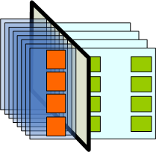
Station architecture
Receiver board
Digital processing board
X pol.
Antennas
Y pol.
Antennas
Architecture: ADCs centrally

Slide 6
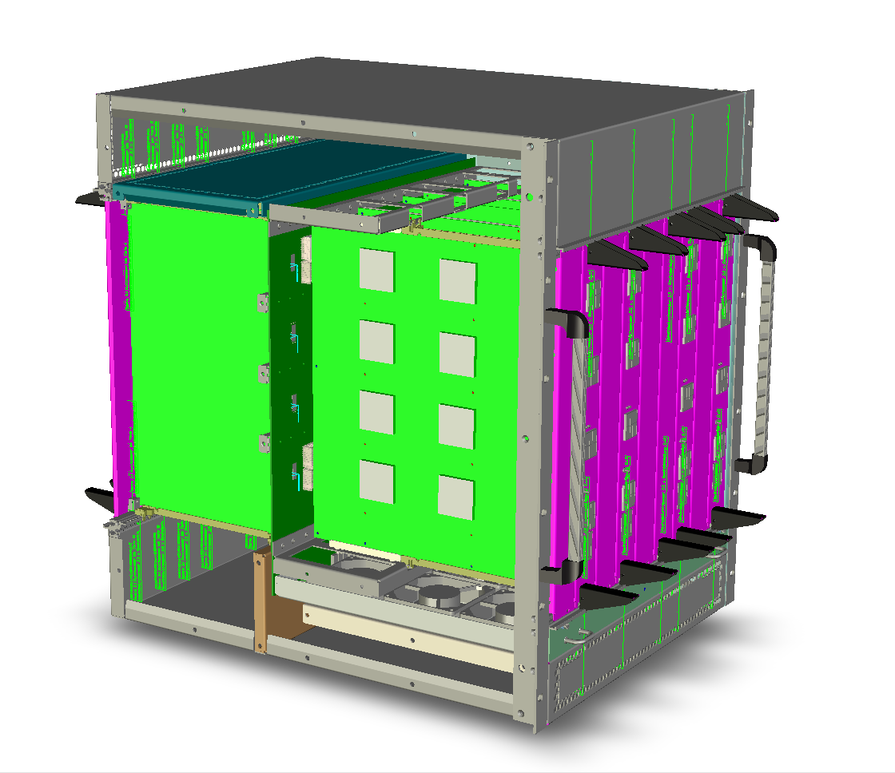
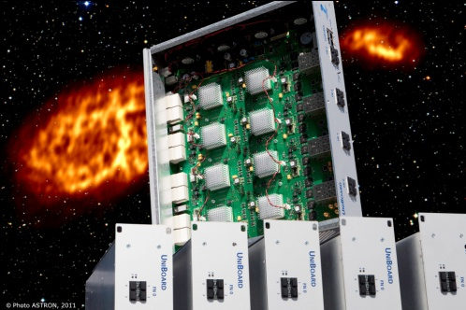
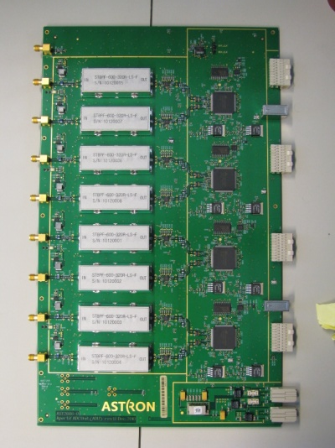
UniBoard Related Hardware
ADU
UniBoard
Presented December 2011

Slide 7
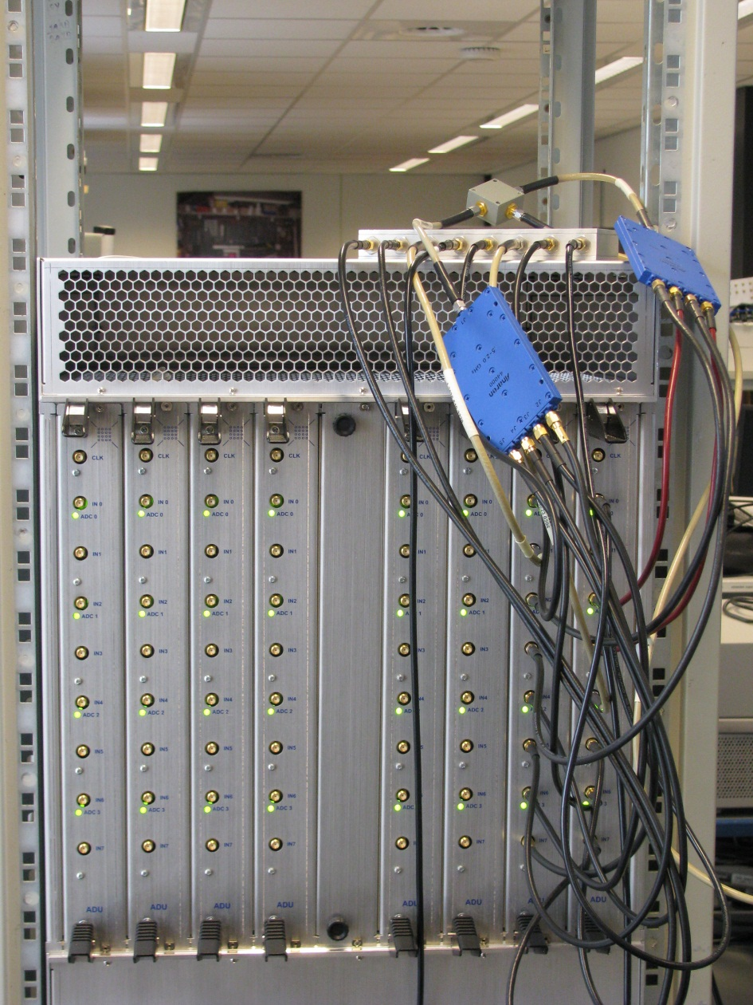
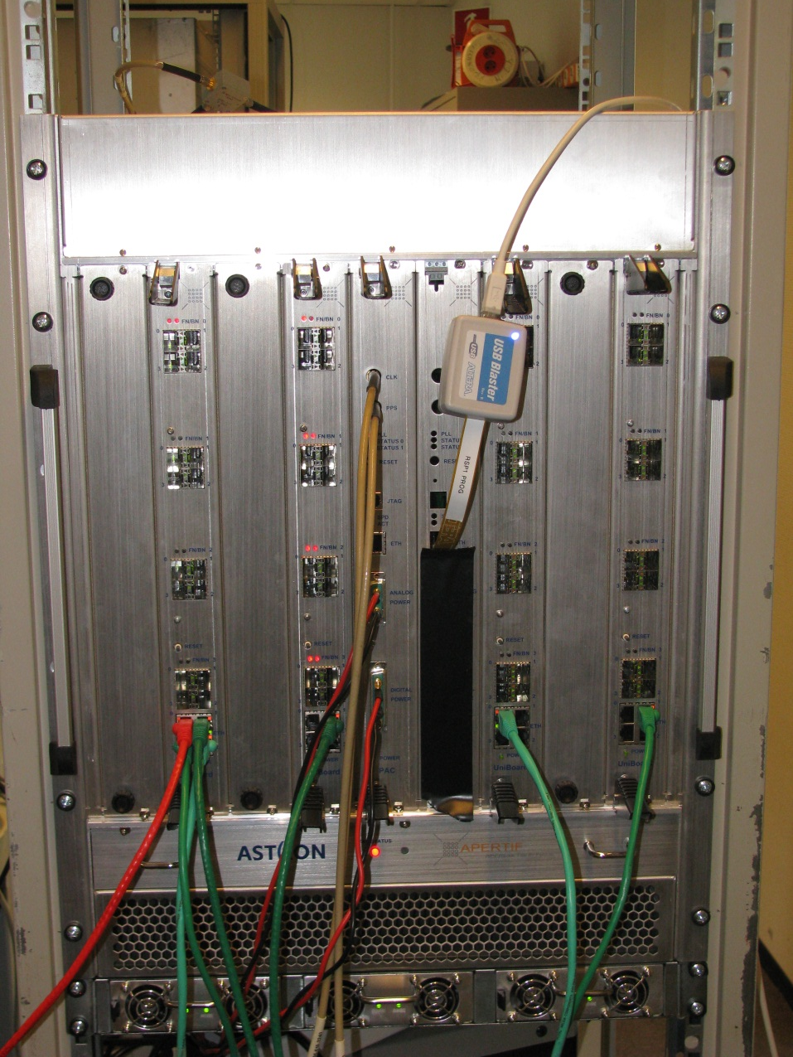
Current Status

Slide 8

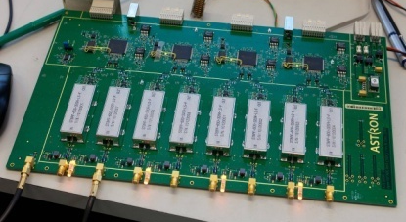
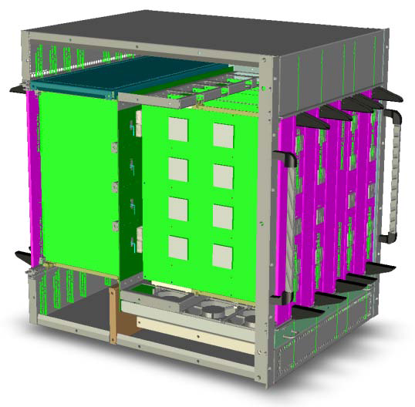
Status
Processing board ready
Power and clock board ready
Integrated in one subrack
Data from ADU can be processed
Beamformer firmware in advanced state
AU

Slide 9
Hardware Numbers
ADU
  400-800 MHz (can be modified)
  Dual ADC with fmax=1 GHz
  8 bit
UniBoard
  16 signal paths
  Input bandwidth: 400 MHz
  Output bandwidth: 40 beams of 300 MHz

Slide 10
AAVS0.5 Uniboard requirements

Slide 11
Required changes for AAVS0.5
ADU filter removed
Sampling @ 1 GHz
UniBoard input bandwidth 1 GHz

Slide 12
Current Uniboard development
In full mode the Uniboard hardware can produce 384 sub-bands x 42 beams (39 bits) through its 10 GbE interfaces.
Through its 1GbE interface (assuming 80% efficiency of UDP), it can produce 50 MHz of beam data which assuming 1GSamples/s clock corresponds to 100 sub-bands (split between frequency bands and FoV in anyway desired).

Slide 13
Adapting Uniboard to AA-low
The ADU hardware needs to be changed (Gijs) to include new filters and a PLL clock at 1GHz. Filters can be incorporated at a later stage as they take time to be procured. This task is achievable within the next 2/3 months.
The firmware (VHDL) needs to be adapted for this new sampling frequency and this requires quite some man hours. There was discussion about who could do this as the three Firmware staff (Harm-Jan, Daniel and Erik) are committed to developing firmware for Apertif. There are potential firmware developers also at INAF, Oxford (Kris) and ICRAR (Nathan)
There are no “top” level python scripts as of yet which set the weights for a sub-band and specific antenna. This requires a little time in dealing with coefficient register mapping but does not present a major challenge.
There are many python scripts already available which can be used with little or no changes for controlling Uniboard hardware (e.g. quick power spectrum, temperature and other utility functions) .
There is no “triggered weight update” mechanism but this does not present a significant challenge.
Data capture is also a viable option for offline correlations.

Slide 14
Mid-October Decisions
Decision about hardware
  Half a subrack for Cambridge
  Half a subrack for ICRAR
Decision about change of subrack to 1 GHz
  Start the redesign of ADU (backwards compatible)
  LVDS interface between ADU and UniBoard pushed to the max.
  Preferably change UniBoard firmware
Development high level Python code
  Nima or Gijs or MFAA person
Cambridge develops pre-ADU board
Target delivery to Cambridge: February 2013
Target implementation at site: August 2013

